Slide 1
World Demographics Analysis Dashboard
File created on: 9/14/2022 4:57:01 PM

Slide 2
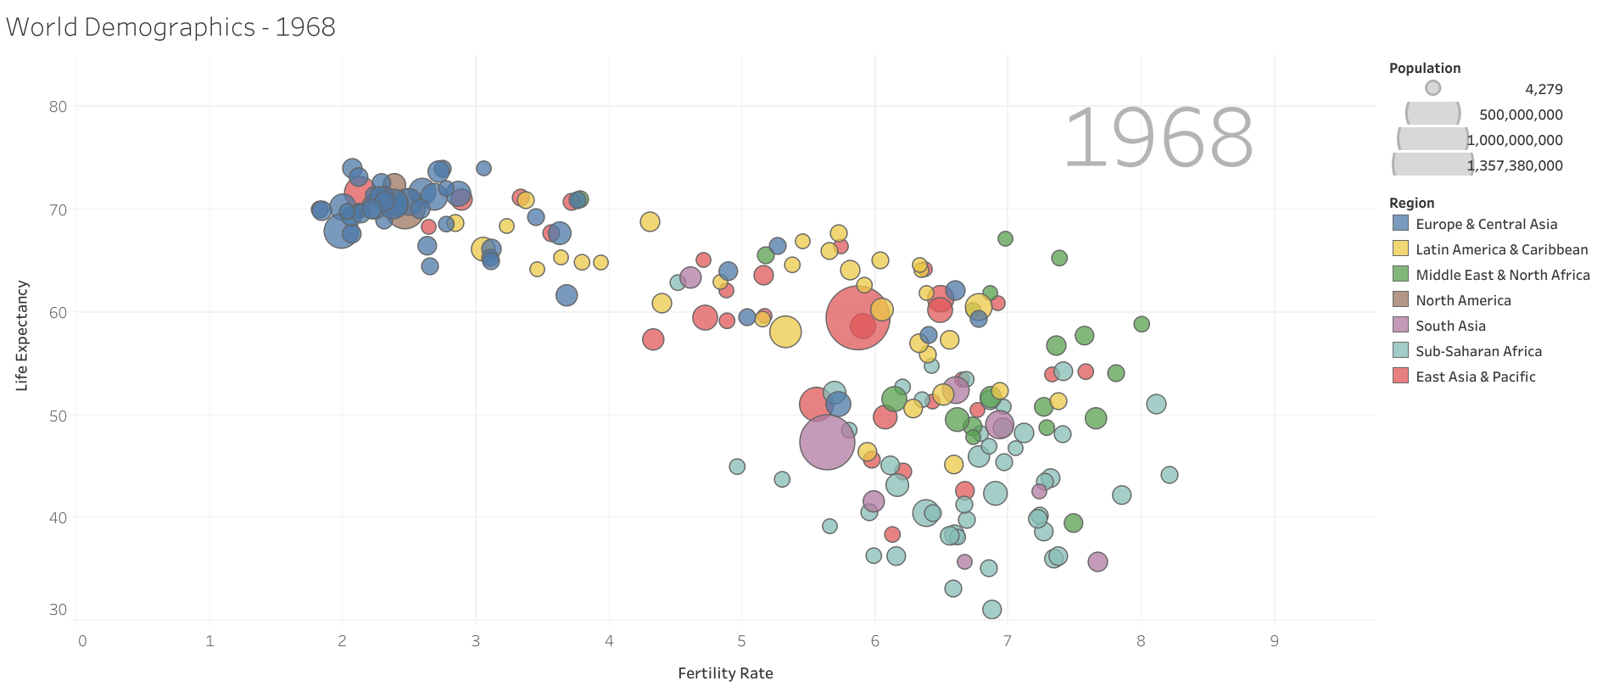

Slide 3
